Slide 1


Lab In Data Analysis
Avishay Bar | 316165984
Liad Garbois | 206714958

Slide 2






Road Map
Introduction
Dataset Overview
Data Preparation & Cleaning
General Analysis
Deep Analysis
Insights & Conclusion

Slide 3
Road Map
Introduction
Dataset Overview
Data Preparation & Cleaning
General Analysis
Deep Analysis
Insights & Conclusion

Slide 4



Introduction
After the COVID-19 pandemic, mobile phones and laptops became essential tools for everyone, regardless of their occupation.
Many brands produce laptops and mobile phones, each featuring its own unique processor.
Nowadays, social media influencers earn a living using only their mobile phones and laptops. Moreover, these devices store much of people's sensitive and personal information.
Consumers often choose devices based on memory specifications, making it a key factor in purchasing decisions. Cloud services help, but many users still prefer ample local storage for speed, privacy, and offline access.

Slide 5
Road Map
Introduction
Dataset Overview
Data Preparation & Cleaning
General Analysis
Deep Analysis
Insights & Conclusion

Slide 6
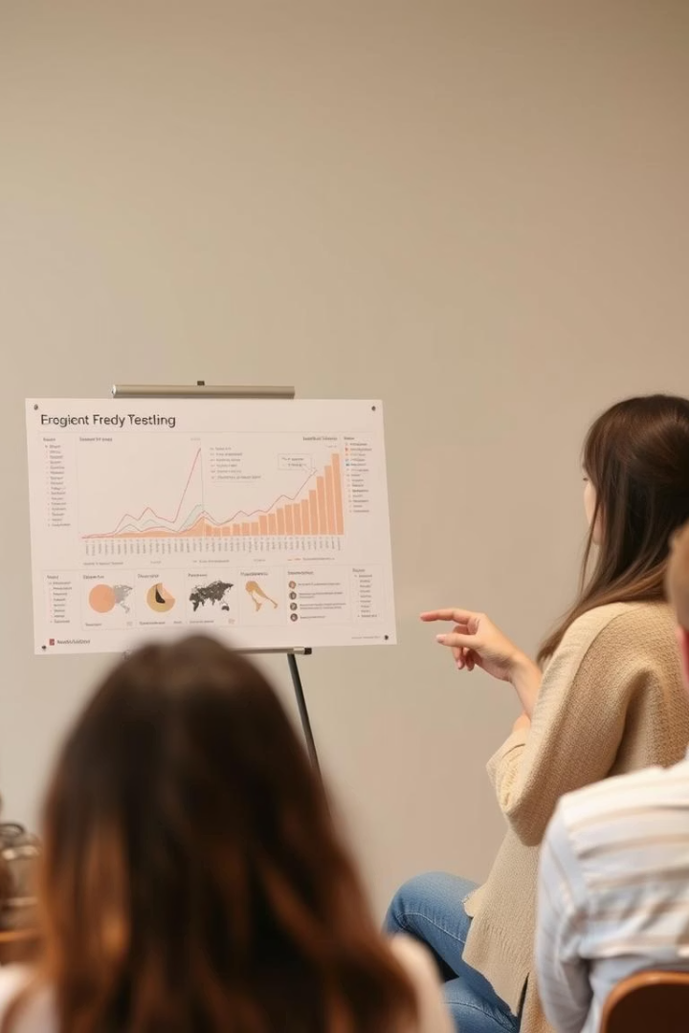


Dataset Overview
Dataset Theme
Simulated sales transactions for mobile phones and laptops
Data Included
Product specifications, Customer details and Sales information
Size
50,000 rows and 16 columns.

Slide 7

Dataset Overview
Product Information
Product
Brand
Product Code
Product Specification
Type of product (Mobile Phone / Laptop).
Various brands like Apple, Samsung, Dell, Lenovo, OnePlus, etc.
Unique identifier for each product.
Brief description of the product features.

Slide 8
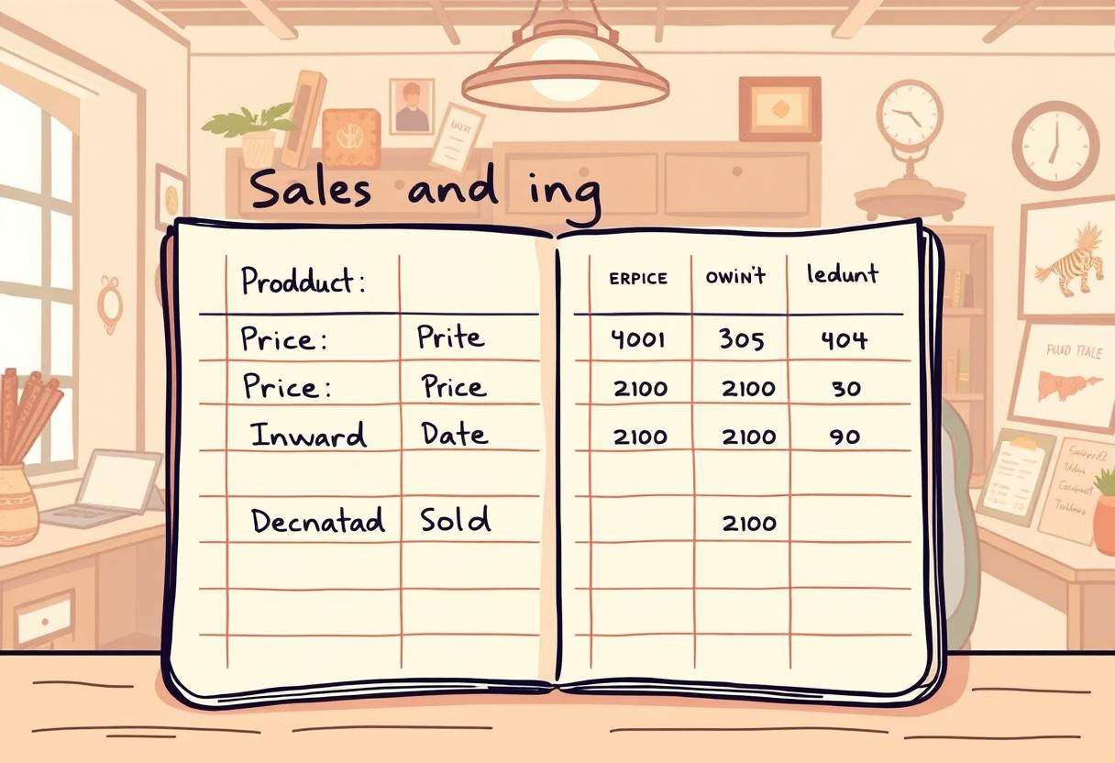
Dataset Overview
Sales & Pricing Details
Price
Inward Date
Dispatch Date
Quantity Sold
Cost of the product (randomly generated).
Date when the product was received in stock.
Date when the product was sold/dispatched.
Number of units sold per transaction.

Slide 9
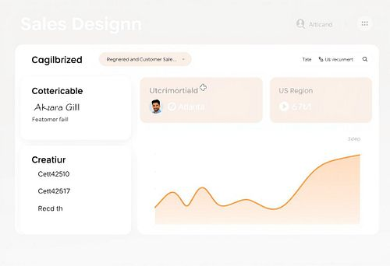
Dataset Overview
Customer & Location Details
Customer Name
Customer Location
Region
Randomly generated customer names.
City of the customer.
Sales region (North, South, East, West, Central).

Slide 10

Dataset Overview
Technical Specifications
Core Specification
Processor Specification
RAM
Includes processor models like i3, i5, i7, i9, Ryzen 3-9 (For Laptops).
Includes processors like Snapdragon, Exynos, Apple A-Series, and MediaTek Dimensity (For Mobiles).
Randomly assigned memory sizes (4GB to 32GB).
ROM
SSD
Storage capacity (64GB to 1TB).
Additional storage (256GB to 2TB), "N/A" for mobile phones (For Laptops).

Slide 11
Road Map
Introduction
Dataset Overview
Data Preparation & Cleaning
General Analysis
Deep Analysis
Insights & Conclusion

Slide 12
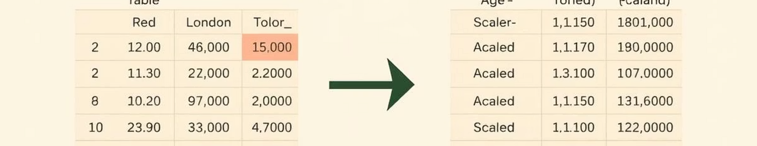
Data Preparation and Cleaning
Handle Missing Data
1
Since missing values appeared only in specific columns related to either mobiles or laptops, we split the base DataFrame into two separate DataFrames - one for mobiles and one for laptops.
Column Filtering
2
Removed unnecessary columns for streamlined analysis.
Data type conversion
3
converted relevant columns to appropriate data types - such as transforming date columns to datetime format and memory values to numeric types.

Slide 13
Road Map
Introduction
Dataset Overview
Data Preparation & Cleaning
General Analysis
Deep Analysis
Insights & Conclusion

Slide 14
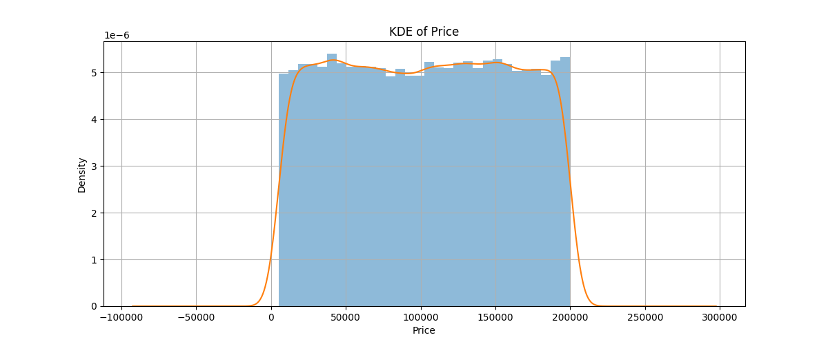
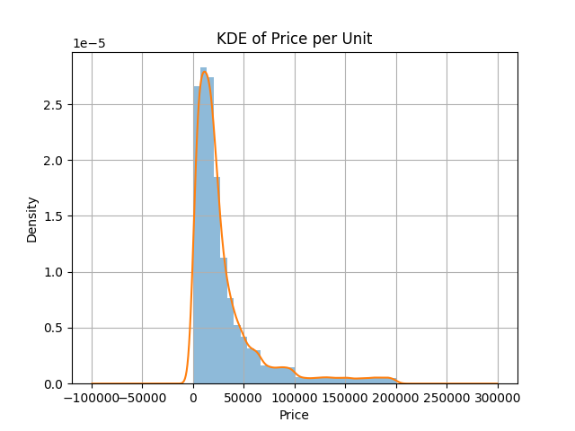
Descriptive Statistics
 | Quantity Sold | Transaction Price | Product Price
Mean | 5.51378 | 102641.407080 | 30051.675203
Standard deviation | 2.88101 | 56363.550361 | 35002.698708
Min | 1.0 | 5008.0 | 503.2
Max | 10.0 | 199999.0 | 199999.0
Median | 6.0 | 103072.0 | 18621.83
Variance | 8.300216 | 3.1768e+09 | 1.225189e+09

Slide 15
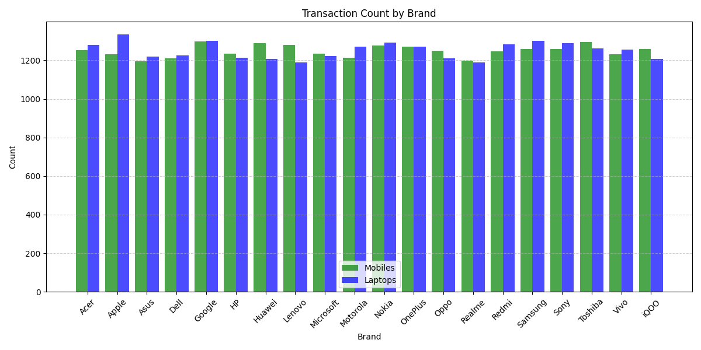
Descriptive Statistics

Slide 16
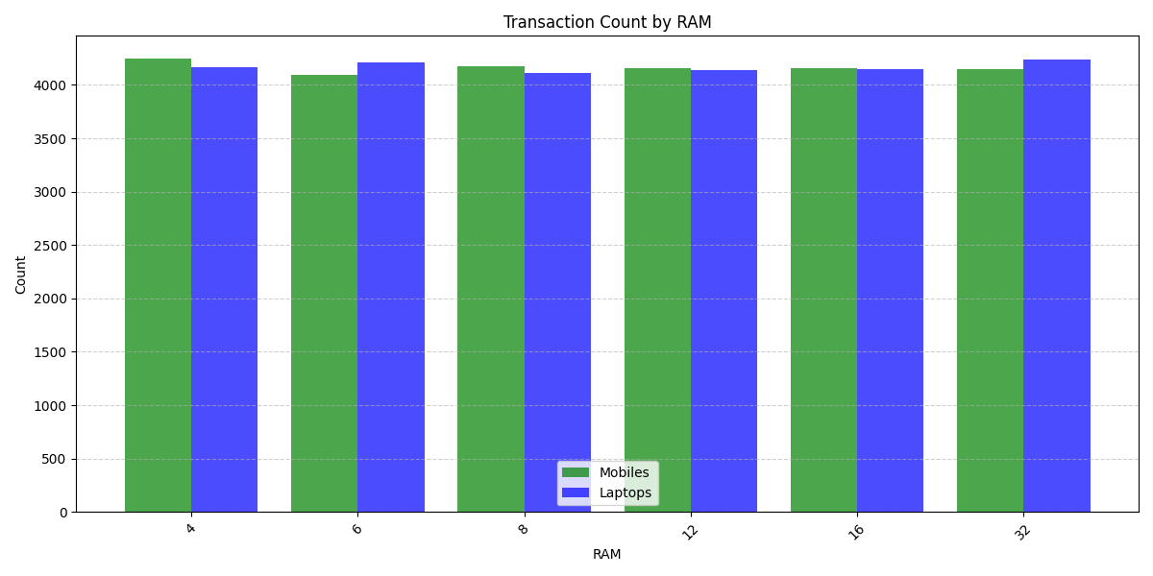
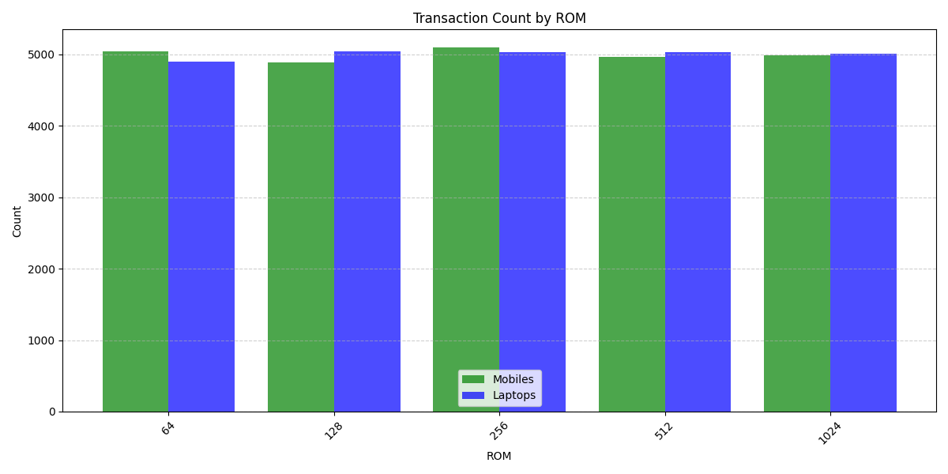
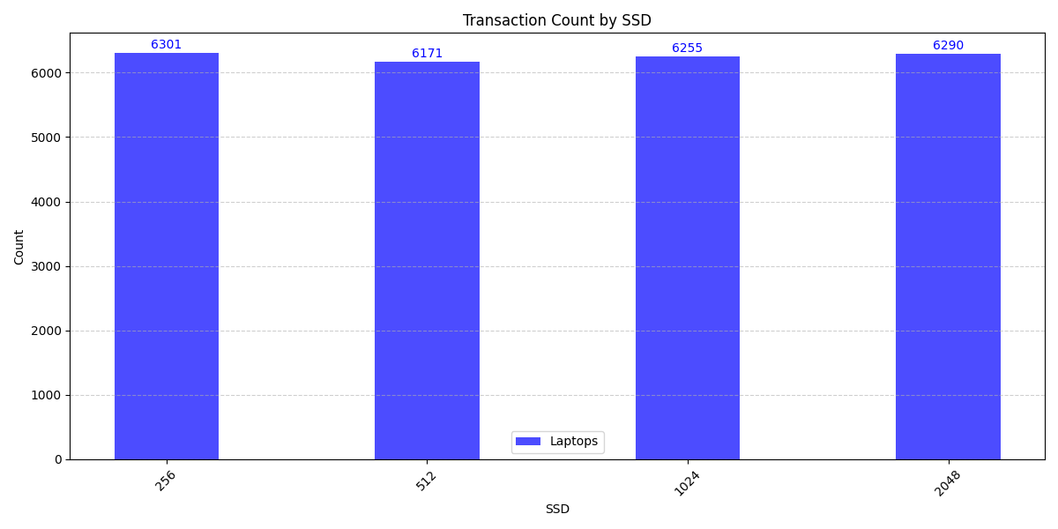
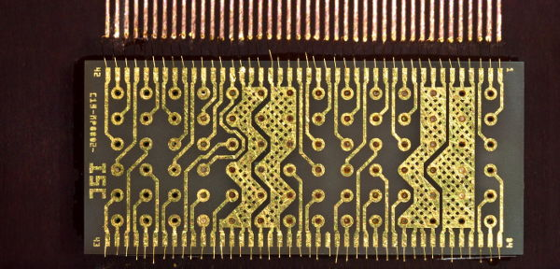
Descriptive Statistics

Slide 17
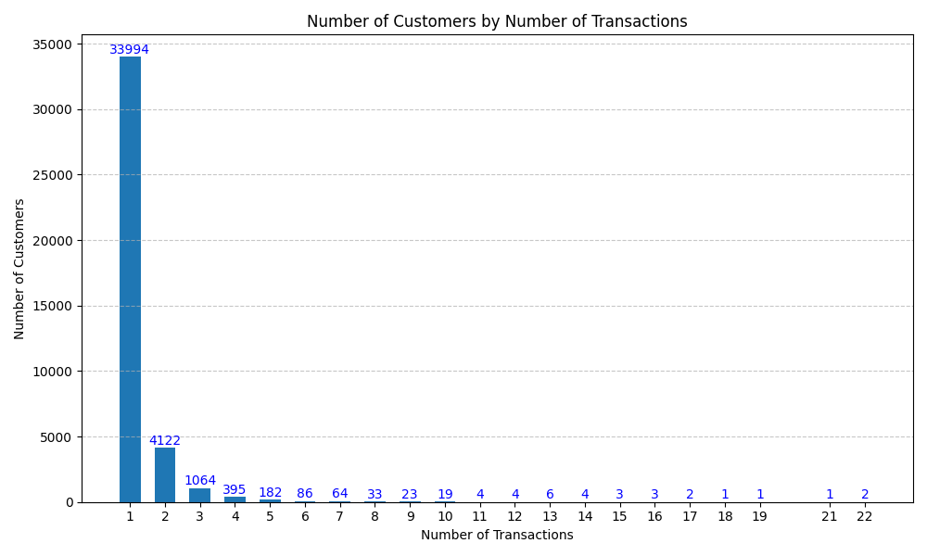

Descriptive Statistics

Slide 18
Road Map
Introduction
Dataset Overview
Data Preparation & Cleaning
General Analysis
Deep & Complex Analysis
Insights & Conclusion

Slide 19

Key Objectives
1
Identify Regional Transaction Patterns
Analyse how sales volume and product preferences vary across different regions.
2
Explore Memory Size Popularity
Investigate the distribution and customer preferences for RAM, ROM, and SSD configurations across product types.
3
Analyse Processor and Core Popularity Over Time
Track trends in the popularity of processor types and core specifications across time.
4
Assess Brand Popularity Laptops Over Time
Compare brand performance by examining transaction frequency and sales trends over time for both product categories.

Slide 20
Identify Regional Transaction Patterns

Slide 21
Identify Regional Transaction Patterns

Slide 22
Analyse Processor and Core Popularity Over Time

Slide 23
Assess Brand Popularity Laptops Over Time

Slide 24



Data Exploration and Insights
Statistical Summary
Distribution Plots
Categorical Analysis
Visualize the distribution of numerical variables using histograms, Kernel Density Estimation (KDE), etc.
Calculate mean, median, variance, etc., to understand the distribution and central tendency of variables.
Explore categorical variables using bar plots to understand frequency and distribution.

Slide 25
Road Map
Introduction
Dataset Overview
Data Preparation & Cleaning
General Analysis
Deep & Complex Analysis
Insights & Conclusion

Slide 26



Major Findings
Groupby()
1
Summarize data based on groupings.
Pivot Tables
2
Create multi-dimensional tables for cross-tabulation and analysis.
Insights
3
Identify patterns, trends, and relationships within groups.

